Slide 1
Sprint 3 Review
ESMS
Jacob Holz, Gilbert Lavin, Parker Steach, Landon Moon, Nam Huynh

Slide 2

Sprint Goal
We will get out first draft for our ADS document and research the specific interface we will be using for SMS communication on Android.

Slide 3
Product Backlog Items
Backlog Item | Estimate | Actual
Write the Architectual Design Specification document | 41 Hours | 34 Hours
Research Android SMS Interfaces | 44 Hours | 20 Hours
Continue Learning Jetpack Compose | 25 Hours | 5 Hours
Total: | 110 Hours | 59 Hours

Slide 4
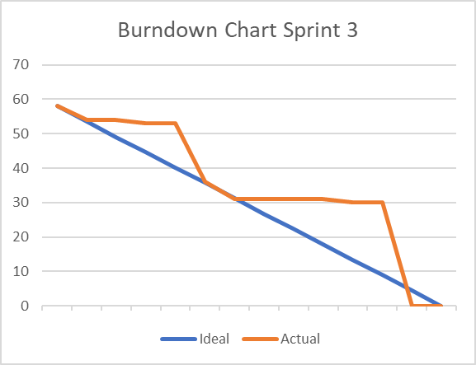
Sprint Burn Down Chart
We were unexpectedly busy with other classes this sprint.
Large amounts of progress was made on each Friday.
Some less vital tasks were not worked toward very much.

Slide 5
What did we do?
We completed the first draft of the ADS
Started with an initial discussion about how the design should flow.
Compiled and revised the parts to fit together.
Got some initial research and development into Android system SMS interface and additionally contacts interfaces.
Made some initial UI components along with a rework of the navigation system.
Retrieved contact and SMS message history from the Android phone emulator.

Slide 6
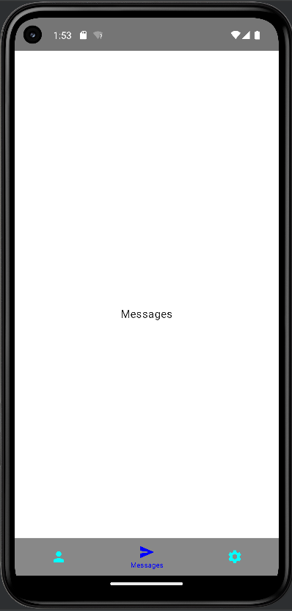
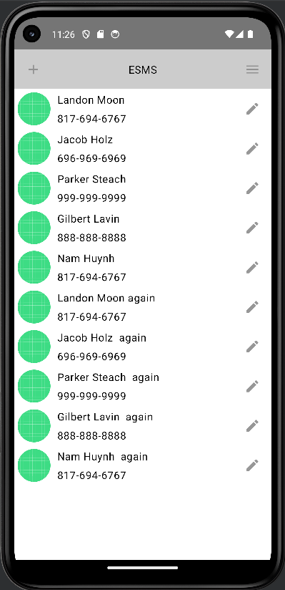
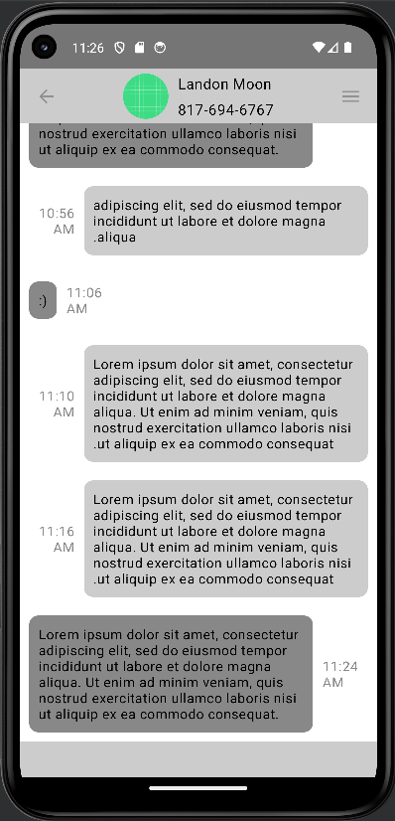
Demo

Slide 7
Questions?

Slide 8
Sprint Backlog for Item 1
Backlog Item | Estimate | Actual
Initial design discussion | 1 Hour | 2 Hours
Decide on the requirements | 5 Hours | 4 Hours
Codifying the decisions in the document | 34 Hours | 30 Hours
Total: | 41 Hours | 36 Hours
Write the Architectual Design Specification document

Slide 9
Sprint Backlog for Item 2
Backlog Item | Estimate | Actual
Make basic UI components and an initial app layout | 15 Hours | 10 Hours
Research android SMS interface | 5 Hours | 3 Hours
Implement SMS interface | 24 Hours | 7 Hours
Total: | 44 Hours | 20 Hours
Research Android SMS Interfaces

Slide 10
Sprint Backlog for Item 3
Backlog Item | Estimate | Actual
Learn through experience with initial development of the app. | 5 Hours / Each | 1 Hour / Each
Total: | 25 Hours | 5 Hours
Continue Learning Jetpack Compose

